Slide 1
Método de Quine-McCluskey
Reducción de miniterminos

Slide 2
Terminología
Mintermino
Implicante
Cubierta
Implicante Primario (Principal)
Implicante Esencial Primaria (Principal)
Implicante Segundo Principal
Suma Mínima

Slide 3
Methodology
Implicant Chart
Minterms
Prime Implicants
Prime Implicant Chart
Essential Prime Implicants
Secondary Prime Implicants
Minimal Cover

Slide 4
Gráfico Implicante
 | Column I |  |  | Column II |  |  | Column III
Group 0 | 0 | 0000 | ✓ | 0,1 0,2 0,8 | 000- 00-0 -000 | ✓ ✓ ✓ | 0,1,8,9 0,2,8,10 | -00- -0-0
Group 1 | 1 2 8 | 0001 0010 1000 | ✓ ✓ ✓ | 1,5 1,9 2,6 2,10 8,9 8,10 | 0-01 -001 0-10 -010 100- 10-0 | ✓✓ ✓ ✓ ✓ | 2,6,10,14 | --10
Group 2 | 5 6 9 10 | 0101 0110 1001 1010 | ✓ ✓ ✓ ✓ | 5,7 6,7 6,14 10,14 | 01-1 011- -110 1-10 | ✓ ✓
Group 3 | 7 14 | 0111 1110 | ✓ ✓

Slide 5
Gráfico Implicante
 | Column I |  |  | Column II |  |  | Column III
Group 0 | 0 | 0000 | ✓ | 0,1 0,2 0,8 | 000- 00-0 -000 | ✓ ✓ ✓ | 0,1,8,9 0,2,8,10 | -00- -0-0
Group 1 | 1 2 8 | 0001 0010 1000 | ✓ ✓ ✓ | 1,5 1,9 2,6 2,10 8,9 8,10 | 0-01 -001 0-10 -010 100- 10-0 | ✓✓ ✓ ✓ ✓ | 2,6,10,14 | --10
Group 2 | 5 6 9 10 | 0101 0110 1001 1010 | ✓ ✓ ✓ ✓ | 5,7 6,7 6,14 10,14 | 01-1 011- -110 1-10 | ✓ ✓
Group 3 | 7 14 | 0111 1110 | ✓ ✓

Slide 6
Gráfico Implicante
 | Column I |  |  | Column II |  |  | Column III
Group 0 | 0 | 0000 | ✓ | 0,1 0,2 0,8 | 000- 00-0 -000 | ✓ ✓ ✓ | 0,1,8,9 0,2,8,10 | -00- -0-0
Group 1 | 1 2 8 | 0001 0010 1000 | ✓ ✓ ✓ | 1,5 1,9 2,6 2,10 8,9 8,10 | 0-01 -001 0-10 -010 100- 10-0 | ✓✓ ✓ ✓ ✓ | 2,6,10,14 | --10
Group 2 | 5 6 9 10 | 0101 0110 1001 1010 | ✓ ✓ ✓ ✓ | 5,7 6,7 6,14 10,14 | 01-1 011- -110 1-10 | ✓ ✓
Group 3 | 7 14 | 0111 1110 | ✓ ✓

Slide 7
Gráfico Implicante
 | Column I |  |  | Column II |  |  | Column III
Group 0 | 0 | 0000 | ✓ | 0,1 0,2 0,8 | 000- 00-0 -000 | ✓ ✓ ✓ | 0,1,8,9 0,2,8,10 | -00- -0-0
Group 1 | 1 2 8 | 0001 0010 1000 | ✓ ✓ ✓ | 1,5 1,9 2,6 2,10 8,9 8,10 | 0-01 -001 0-10 -010 100- 10-0 | ✓✓ ✓ ✓ ✓ | 2,6,10,14 | --10
Group 2 | 5 6 9 10 | 0101 0110 1001 1010 | ✓ ✓ ✓ ✓ | 5,7 6,7 6,14 10,14 | 01-1 011- -110 1-10 | ✓ ✓
Group 3 | 7 14 | 0111 1110 | ✓ ✓

Slide 8
Gráfico Implicante
 | Column I |  |  | Column II |  |  | Column III
Group 0 | 0 | 0000 | ✓ | 0,1 0,2 0,8 | 000- 00-0 -000 | ✓ ✓ ✓ | 0,1,8,9 0,2,8,10 | -00- -0-0
Group 1 | 1 2 8 | 0001 0010 1000 | ✓ ✓ ✓ | 1,5 1,9 2,6 2,10 8,9 8,10 | 0-01 -001 0-10 -010 100- 10-0 | ✓ ✓ ✓ ✓ ✓ | 2,6,10,14 | --10
Group 2 | 5 6 9 10 | 0101 0110 1001 1010 | ✓ ✓ ✓ ✓ | 5,7 6,7 6,14 10,14 | 01-1 011- -110 1-10 | ✓ ✓
Group 3 | 7 14 | 0111 1110 | ✓ ✓

Slide 9
Gráfico Implicante
 | Column I |  |  | Column II |  |  | Column III
Group 0 | 0 | 0000 | ✓ | 0,1 0,2 0,8 | 000- 00-0 -000 | ✓ ✓ ✓ | 0,1,8,9 0,2,8,10 | -00- -0-0
Group 1 | 1 2 8 | 0001 0010 1000 | ✓ ✓ ✓ | 1,5 1,9 2,6 2,10 8,9 8,10 | 0-01 -001 0-10 -010 100- 10-0 | ✓ ✓ ✓ ✓ ✓ | 2,6,10,14 | --10
Group 2 | 5 6 9 10 | 0101 0110 1001 1010 | ✓ ✓ ✓ ✓ | 5,7 6,7 6,14 10,14 | 01-1 011- -110 1-10 | ✓ ✓
Group 3 | 7 14 | 0111 1110 | ✓ ✓

Slide 10
Gráfico Implicante principal
 |  |  |  | Minterms
 | PIs | abcd |  | 0 | 1 | 2 | 5 | 6 | 7 | 8 | 9 | 10 | 14
 | (0,1,8,9) | -00- | b'c' | x | x |  |  |  |  | x | x
 | (0,2,8,10) | -0-0 | b'd' | x |  | x |  |  |  | x |  | x
 | (2,6,10,14) | --10 | cd' |  |  | x |  | x |  |  |  | x | x
 | (1,5) | 0-01 | a'c'd |  | x |  | x
 | (5,7) | 01-1 | a'bd |  |  |  | x |  | x
 | (6,7) | 011- | a'bc |  |  |  |  | x | x

Slide 11
Gráfico Implicante principal
 |  |  |  | Minterms
 | PIs | abcd |  | 0 | 1 | 2 | 5 | 6 | 7 | 8 | 9 | 10 | 14
 | (0,1,8,9) | -00- | b'c' | x | x |  |  |  |  | x | x
 | (0,2,8,10) | -0-0 | b'd' | x |  | x |  |  |  | x |  | x
 | (2,6,10,14) | --10 | cd' |  |  | x |  | x |  |  |  | x | x
 | (1,5) | 0-01 | a'c'd |  | x |  | x
 | (5,7) | 01-1 | a'bd |  |  |  | x |  | x
 | (6,7) | 011- | a'bc |  |  |  |  | x | x

Slide 12
Gráfico Implicante principal
 |  |  |  | Minterms
 | PIs | abcd |  | 0 | 1 | 2 | 5 | 6 | 7 | 8 | 9 | 10 | 14
✓ | (0,1,8,9) | -00- | b'c' | x | x |  |  |  |  | x | ⊗
 | (0,2,8,10) | -0-0 | b'd' | x |  | x |  |  |  | x |  | x
✓ | (2,6,10,14) | --10 | cd' |  |  | x |  | x |  |  |  | x | ⊗
 | (1,5) | 0-01 | a'c'd |  | x |  | x
 | (5,7) | 01-1 | a'bd |  |  |  | x |  | x
 | (6,7) | 011- | a'bc |  |  |  |  | x | x
⊗ Essential Prime Implicant

Slide 13
Gráfico Implicante principal
 |  |  |  | ✓ | ✓ | ✓ |  | ✓ |  | ✓ | ✓ | ✓ | ✓
 | PIs | abcd |  | 0 | 1 | 2 | 5 | 6 | 7 | 8 | 9 | 10 | 14
✓ | (0,1,8,9) | -00- | b'c' | x | x |  |  |  |  | x | ⊗
 | (0,2,8,10) | -0-0 | b'd' | x |  | x |  |  |  | x |  | x
✓ | (2,6,10,14) | --10 | cd' |  |  | x |  | x |  |  |  | x | ⊗
 | (1,5) | 0-01 | a'c'd |  | x |  | x
 | (5,7) | 01-1 | a'bd |  |  |  | x |  | x
 | (6,7) | 011- | a'bc |  |  |  |  | x | x

Slide 14
Gráfico Implicante principal
 |  |  |  | ✓ | ✓ | ✓ | ✓ | ✓ | ✓ | ✓ | ✓ | ✓ | ✓
 | PIs | abcd |  | 0 | 1 | 2 | 5 | 6 | 7 | 8 | 9 | 10 | 14
✓ | (0,1,8,9) | -00- | b'c' | x | x |  |  |  |  | x | ⊗
 | (0,2,8,10) | -0-0 | b'd' | x |  | x |  |  |  | x |  | x
✓ | (2,6,10,14) | --10 | cd' |  |  | x |  | x |  |  |  | x | ⊗
 | (1,5) | 0-01 | a'c'd |  | x |  | x
✓ | (5,7) | 01-1 | a'bd |  |  |  | x |  | x
 | (6,7) | 011- | a'bc |  |  |  |  | x | x
f = b'c' + cd' + a'bd

Slide 15
Summary (sumario)
Quine-McCluskey
Implicant Chart
Prime Implicants
Essential Prime Implicants
Minimum Sum of Products
Don't Cares (No se preocupe)

Slide 16
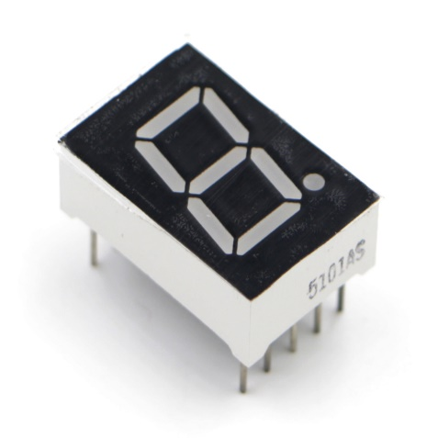
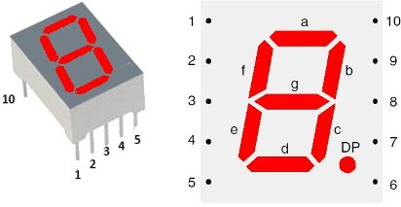
Display de 7 segmentos

Slide 17
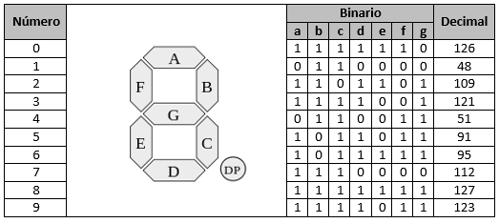
Ejemplo de Diseño

Slide 18
Ejemplo de Diseño

Slide 19
BCD to 7-Seg. Truth Table

Slide 20
BCD to 7-Seg. Truth Table

Slide 21
Minterm Form of Outputs
a(D₃,D₂,D₁,D₀) = Σm(0,2,3,5,6,7,8,9) + Σd(10-15)
b(D₃,D₂,D₁,D₀) = Σm(0,1,2,3,4,7,8,9) + Σd(10-15)
c(D₃,D₂,D₁,D₀) = Σm(0,1,3-9) + Σd(10-15)
d(D₃,D₂,D₁,D₀) = Σm(0,2,3,5,6,8,9) + Σd(10-15)
e(D₃,D₂,D₁,D₀) = Σm(0,2,6,8) + Σd(10-15)
f(D₃,D₂,D₁,D₀) = Σm(0,4,5,6,8,9) + Σd(10-15)
g(D₃,D₂,D₁,D₀) = Σm(2,3,4,5,6,8,9) + Σd(10-15)

Slide 22
Segment a
D₃D₂ D₁D₀ | 00 | 01 | 11 | 10
00 | 0 | 4 | 12 | 8
01 | 1 | 5 | 13 | 9
11 | 3 | 7 | 15 | 11
10 | 2 | 6 | 14 | 10
1
X
1
a = D₁ + D₃ + (D₂D₀) +
(D₂′D₀′)
1
X
1
1
1
X
X
1
1
X
X
a(D₃,D₂,D₁,D₀) = Σm(0,2,3,5,6,7,8,9) + Σd(10-15)

Slide 23
Segment b
D₃D₂ D₁D₀ | 00 | 01 | 11 | 10
00 | 0 | 4 | 12 | 8
01 | 1 | 5 | 13 | 9
11 | 3 | 7 | 15 | 11
10 | 2 | 6 | 14 | 10
1
1
X
1
b = D₂′ + (D₁′D₀′) + (D₁D₀)
1
X
1
1
1
X
X
1
X
X
b(D₃,D₂,D₁,D₀) = Σm(0,1,2,3,4,7,8,9) + Σd(10-15)

